Slide 1
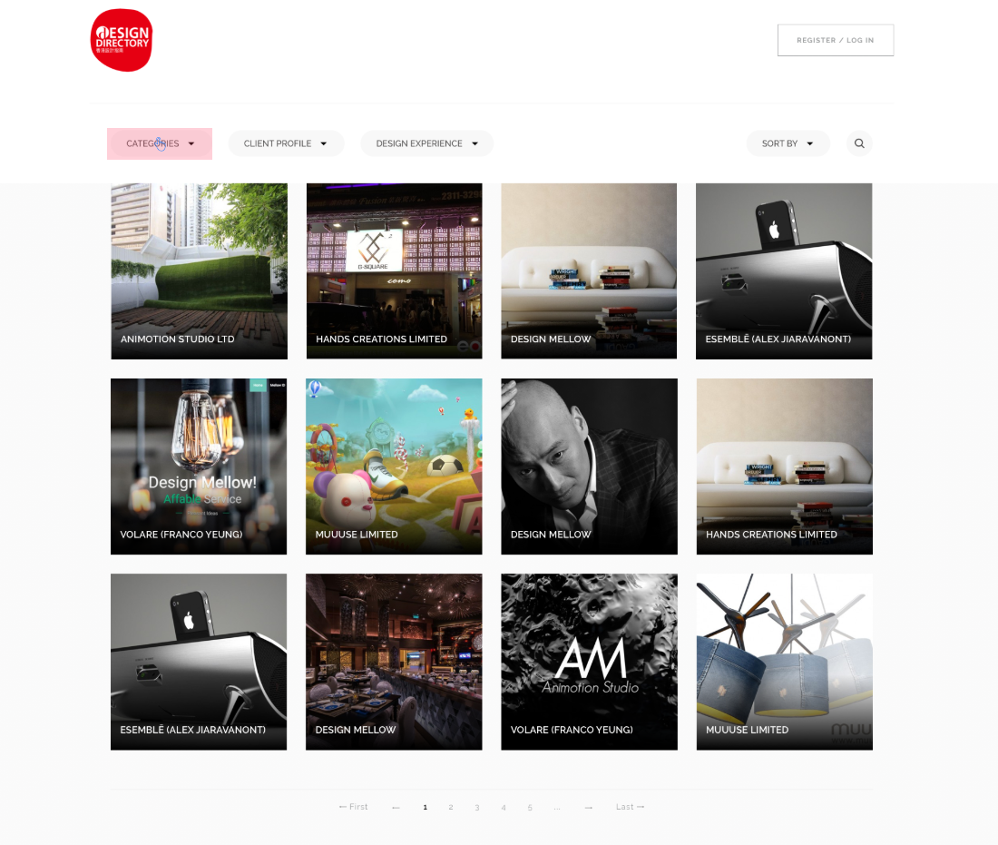
Landing page
Before selecting category / searching
Red border
Show SORT BY above searching result
Put input box
Irregular size (no need to fix at 12 boxes)
After fade out, replace with another image
No need to show pages before filtering

Slide 2
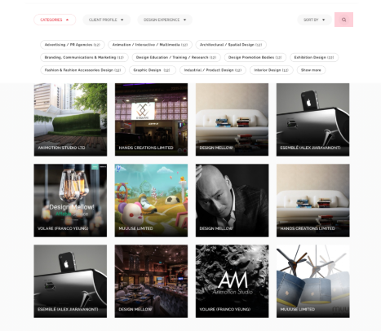

Landing page
After clicking category
Big category
Small category (appear after choosing a big cate)
Show SORT BY above searching result
When choosing Big / Small cate, an option of “fine-tune your search” appear, when clicking on the button,
an input box with grey reminder text shows up (e.g. enter keyword / company name etc. )
After clicking category, the original images all fade out,
12 boxes appears (alphabetical order?), show page number on below,
select category: ALL by default
Please note that keyword for “fine-tune your search” will also show here in grey

Slide 3
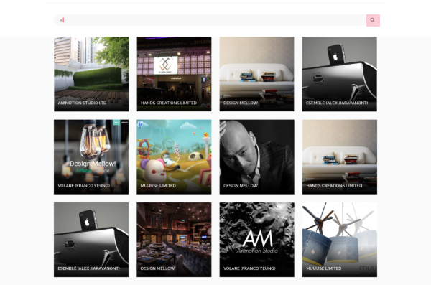
Landing page
After searching
After inputting content on search box, all images fade out, until user click search
Please also note that if user search “ABC”, company with either name / info including ABC
can be searched

Slide 4
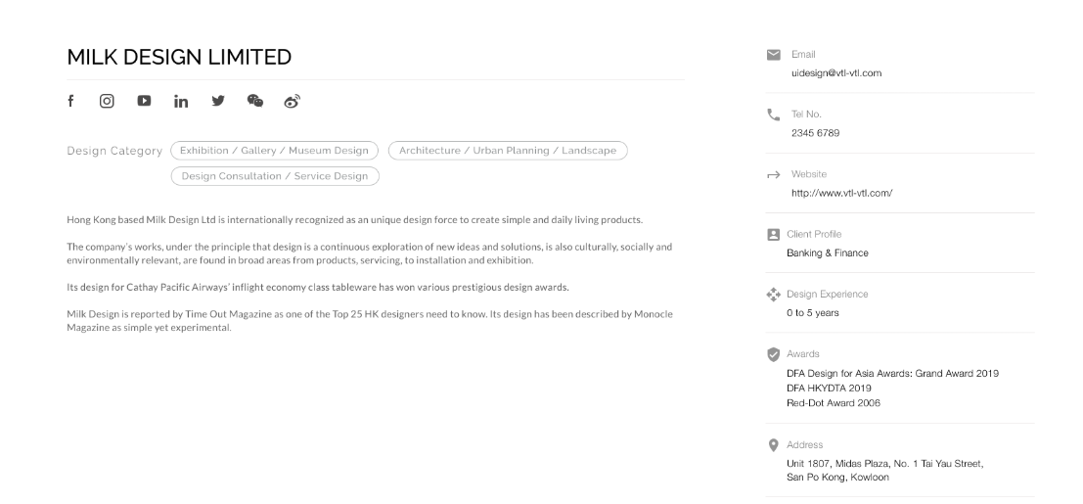
Entity page
We may add some more, will update later
If a company does not have e.g. FB, this icon will not appear
Please follow the order:
Website
Email
Tele
Address
Design Experience
Client profile
Award

Slide 5
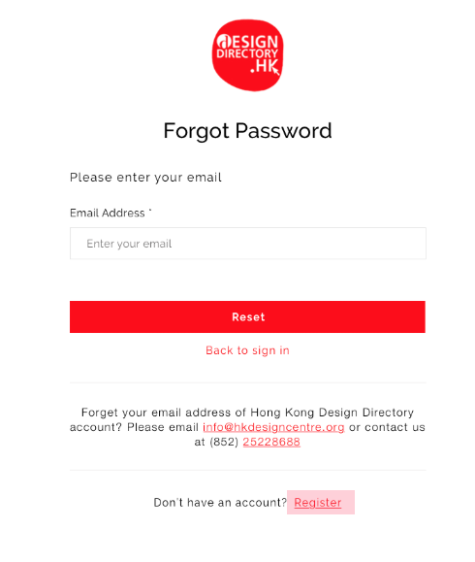
Forgot Password
A bit odd to have red for tele no.

Slide 6
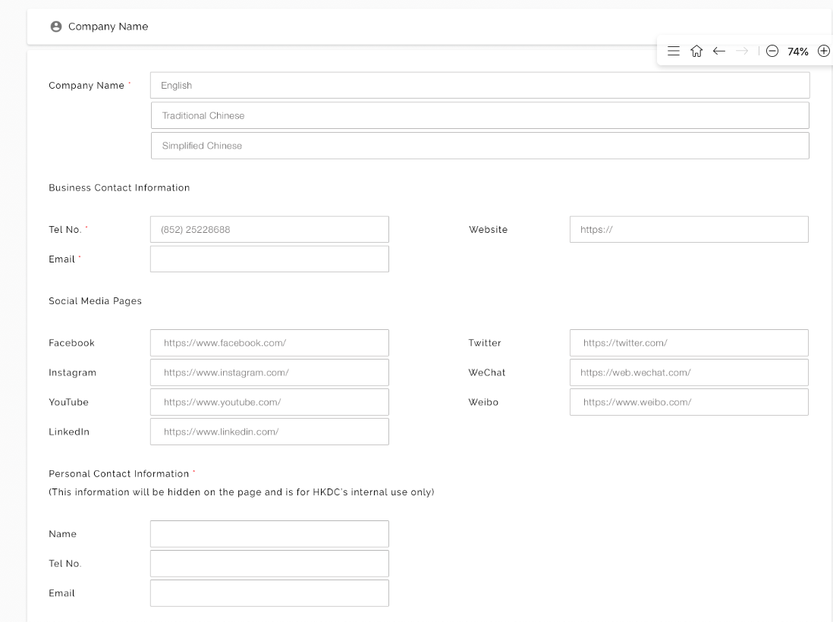
Form
Please bold the title for easy reading
You may add a thin red line to separate sections

Slide 7
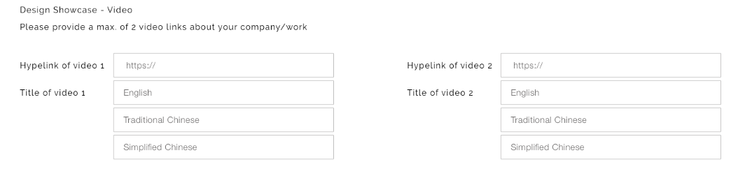
Form
Please take out video

Slide 8
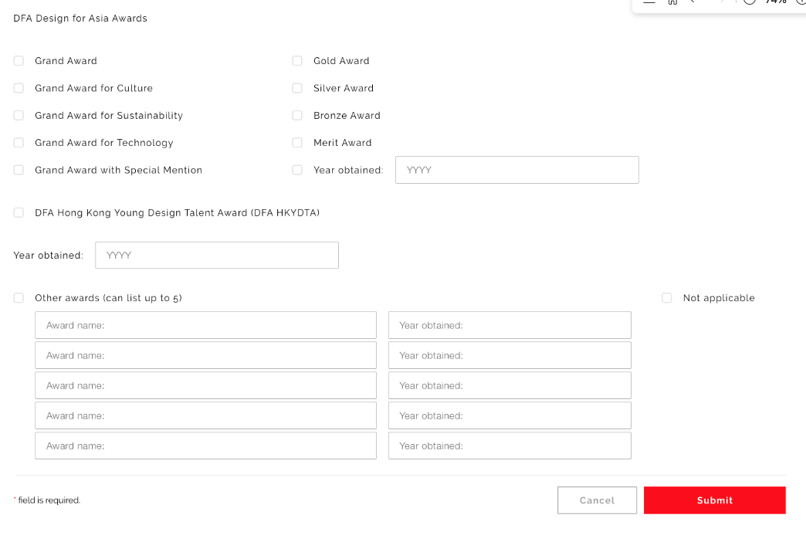
Form
Please allow the user to choose whether they have any DFA award
Only show after users have DFA award
Only show after users select a DFA award, all options in a row together with year obtained
Please allow the user to choose whether they have any other awards
Only show 1 after users have other award
add a + button for user to input more than 1 award
For new user, after they submit the form, their status is pending
for approval and the entity page will not show on design directory.
But for existing user who make changes only, even if they are in pending
for approval, their entity page will continue showing on design directory (with existing content)
Only when HKDC approved the changes, the new update will appear on their page.
For entity created (user make changes only),
the text on button should be “Submit Changes”

Slide 9
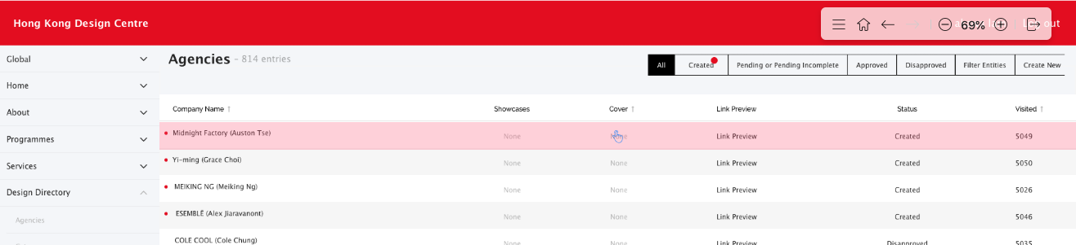
CMS
Please allow to search by company name

Slide 10
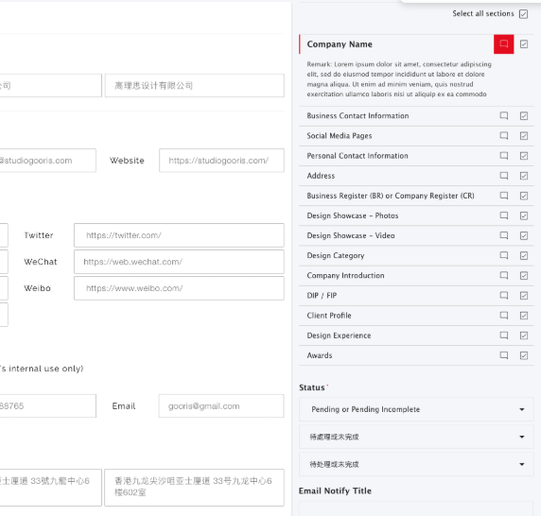
CMS
Instead of checking the “checked ok” content, the logic will be check for fields that have issues
If user is updating content, can the CMS show which content has been updated?

Slide 11
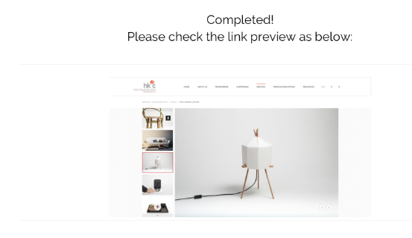
CMS
No need to preview for successful applicants, only embed it to the rejected one

